Slide 1
Data Validation
Thien Khai Tran

Slide 2
DataAnnotations
ASP.NET MVC uses DataAnnotations attributes to implement validations. DataAnnotations includes built-in validation attributes for different validation rules, which can be applied to the properties of model class.
The DataAnnotations attributes included in System.ComponentModel.DataAnnotations namespace

Slide 3
Attribute | Description
Required | Indicates that the property is a required field
StringLength | Defines a maximum length for string field
Range | Defines a maximum and minimum value for a numeric field
RegularExpression | Specifies that the field value must match with specified Regular Expression
CreditCard | Specifies that the specified field is a credit card number
CustomValidation | Specified custom validation method to validate the field
EmailAddress | Validates with email address format
FileExtension | Validates with file extension
MaxLength | Specifies maximum length for a string field
MinLength | Specifies minimum length for a string field
Phone | Specifies that the field is a phone number using regular expression for phone numbers

Slide 4
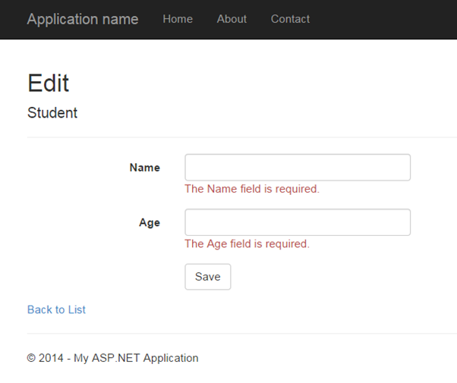
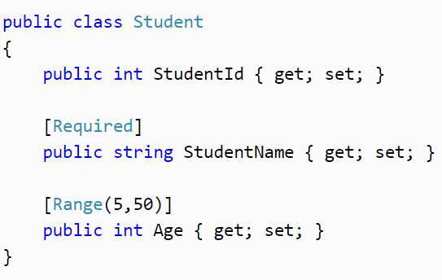
Apply DataAnnotation Attributes
Notes:
model

Slide 5
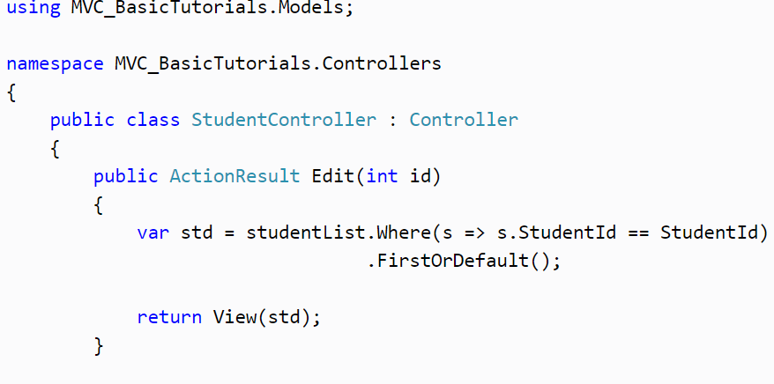
Apply DataAnnotation Attributes
Notes:
Controller: httpGET

Slide 6
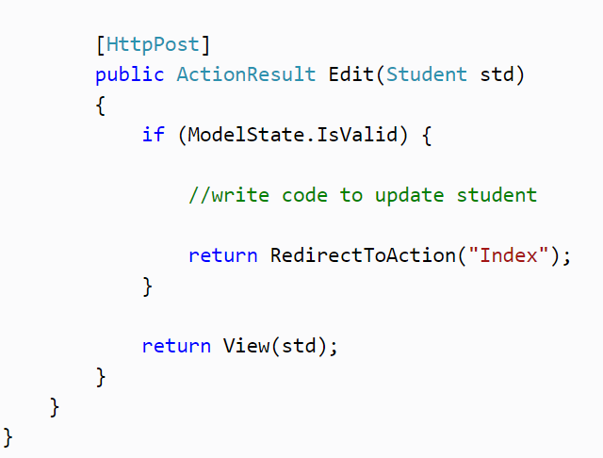
Apply DataAnnotation Attributes
ModelState.IsValid determines that whether submitted values satisfy all the DataAnnotation validation attributes applied to model properties.
Notes:
Controller httpPOST

Slide 7
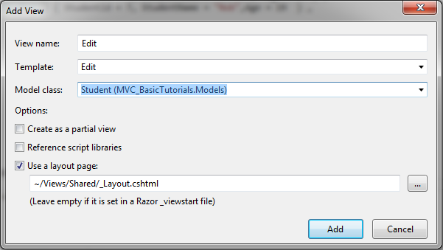
Creating an Edit view for Student.

Slide 8
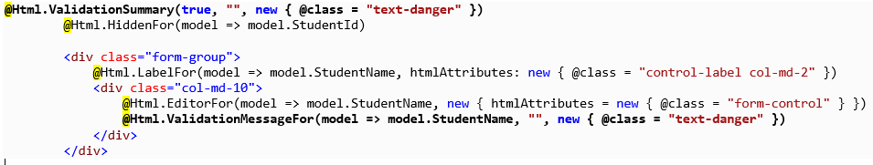
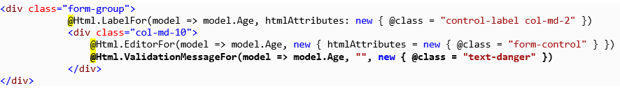
Creating an Edit view for Student
Notes:
it calls Html Helper method ValidationMessageForfor every field and ValidationSummary method at the top. ValidationMessageFor is responsible to display error message for the specified field. ValidationSummary displays a list of all the error messages at once.
So now, it will display default validation message when you submit an Edit form without entering a Name or Age.

Slide 9
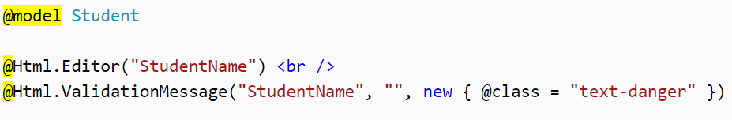
ValidationMessage
In the above example,
The first parameter in the ValidationMessage method is a property name for which we want to show the error message e.g. StudentName.
The second parameter is for custom error message and
The third parameter is for html attributes like css, style etc.
Notes:
The ValidationMessage() method will only display an error, if you have configured the DataAnnotations attribute to the specifed property in the model class. The following is a Student model class where the DataAnnotations attribute "Required" is applied to the StudentName property.

Slide 10
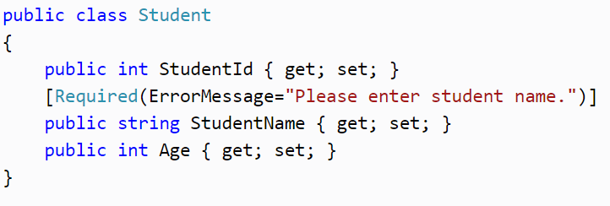
ValidationMessage
Also, you can specify a message as a second parameter in the ValidationMessage() method as shown below.
Notes:
The ValidationMessage() method will only display an error, if you have configured the DataAnnotations attribute to the specifed property in the model class. The following is a Student model class where the DataAnnotations attribute "Required" is applied to the StudentName property.

Slide 11
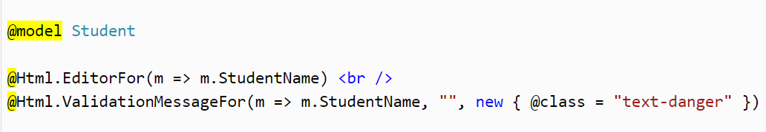
ValidationMessageFor
In the above example, the first parameter in ValidationMessageFor method is a lambda expression to specify a property for which we want to show the error message. The second parameter is for custom error message and the third parameter is for html attributes like css, style etc.
Notes:
The ValidationMessageFor() method will only display an error if you have configured DataAnnotations attribute to the specifed property in the model class. The following example is a Student model class where the DataAnnotations attribute "Required" is applied to the StudentName property.

Slide 12
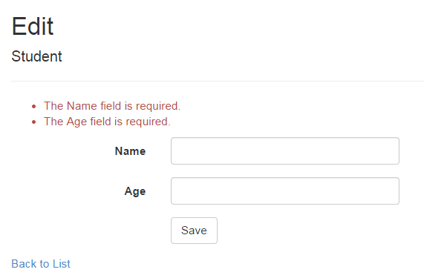
ValidationSummary
The ValidationSummary helper method generates an unordered list (ul element) of validation messages that are in the ModelStateDictionary object.
The ValidationSummary can be used to display all the error messages for all the fields. It can also be used to display custom error messages. The following figure shows how ValidationSummary displays the error messages.
Notes:
By default, ValidationSummary filters out field level error messages. If you want to display field level error messages as a summary then specify excludePropertyErrors = false.
So now, the following Edit view will display error messages as a summary at the top. Please make sure that you don't have a ValidationMessageFor method for each of the fields.

Slide 13
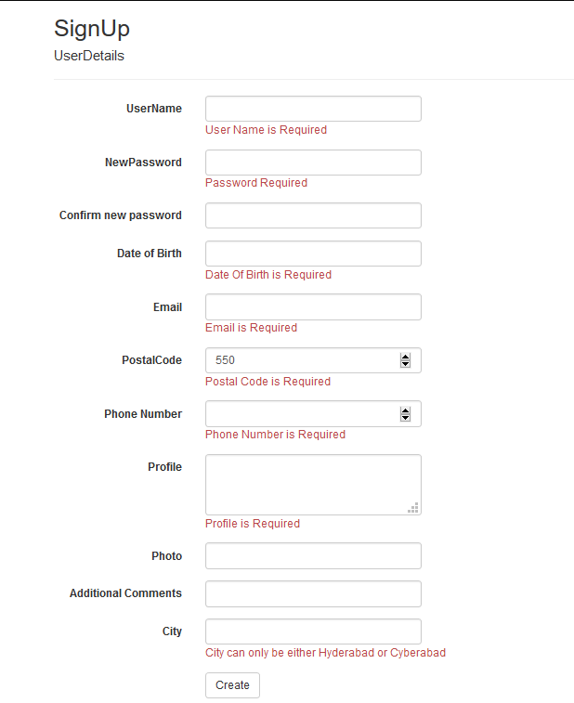

Slide 14
Apply DataAnnotation Attributes
[Required(ErrorMessage = "User Name is Required")]
[StringLength(15, ErrorMessage = "User Name cannot be more than 15 characters")]
[RegularExpression("^[a-zA-Z']{1,15}$", ErrorMessage = "Invalid UserName")]
public string UserName { get; set; }
[Required(ErrorMessage = "Password Required")]
[StringLength(11, MinimumLength = 5, ErrorMessage = "Minimum Length of Password is 5 letters or Max Length is of 11 letters..")]
[DataType("password")]
public string NewPassword { get; set; }
Notes:
You can also apply multiple DataAnnotations validation attributes to a single property if required.

Slide 15
Apply DataAnnotation Attributes
[DataType(DataType.Password)]
[Display(Name = "Confirm new password")]
[System.ComponentModel.DataAnnotations.Compare("NewPassword", ErrorMessage = "The new password and confirmation password do not match.")]
public string ConfirmPassword { get; set; }
[Required(ErrorMessage = "Date Of Birth is Required")]
[DisplayName("Date of Birth")]
[DataType(DataType.Date)]
[DisplayFormat(DataFormatString = "{0:d}", ApplyFormatInEditMode = true)]
public DateTime DateOfBirth { get; set; }
Notes:
// Expected "3/6/2017" string.Format("{0:d}", System.DateTime.Now) "2017-03-06“
// Expected "3/6/2017 09:31:13 AM" (or similar) string.Format("{0}", System.DateTime.Now) "2017-03-06 09:31:13" string.Format("{0:G}", System.DateTime.Now) "2017-03-06 09:31:13"

Slide 16
Apply DataAnnotation Attributes
[Required(ErrorMessage = "Email is Required")]
[EmailAddress(ErrorMessage = "Please enter valid Email Id")]
public string Email { get; set; }
[Required(ErrorMessage = "Postal Code is Required")]
[Range(100, 1000, ErrorMessage = "Must be between 100 and 1000")]
public int PostalCode { get; set; }
[Required(ErrorMessage = "Phone Number is Required")]
[DisplayName("Phone Number")]
public int PhoneNo { get; set; }
[Required(ErrorMessage = "Profile is Required")]
[DataType(DataType.MultilineText)]
public string Profile { get; set; }

Slide 17
Apply DataAnnotation Attributes
[FileExtensions(Extensions = "png,jpg,jpeg,gif")]
public string Photo { get; set; }
[AllowHtml()]
[Display(Name = "Additional Comments")]
public string AdditionalComments { get; set; }
[CustomValidation(typeof(CityValidator), "IsCityValid")]
public string City { get; set; }

Slide 18
Apply DataAnnotation Attributes
public IEnumerable<ValidationResult> Validate(ValidationContext validationContext)
{
ValidationResult vr = null;
if (City.ToLower() == "hyderabad" && PostalCode > 500)
vr = new ValidationResult("Invalid PostalCode for Hyderabad City.");
return new List<ValidationResult>() { vr };
}

Slide 19
class CityValidator
public class CityValidator
{
public static ValidationResult IsCityValid(string City, ValidationContext context)
{
if (string.IsNullOrWhiteSpace(City))
return new ValidationResult("City cannot be null or white space");
if (City.ToLower().Equals("hyderabad") || City.ToLower().Equals("cyberabad"))
return ValidationResult.Success;
return new ValidationResult("City can only be either Hyderabad or Cyberabad");
}
}

Slide 20
Controller
[HttpGet]
public ActionResult SignUp()
{
return View();
}
[HttpPost]
public ActionResult SignUp(UserDetails ud)
{
if (ModelState.IsValid)
{
return Content("Success!");
}
return View(ud);
}

Slide 21
View
@Html.ValidationSummary(true, "", new { @class = "text-danger" })
<div class="form-group">
@Html.LabelFor(model => model.UserName, htmlAttributes: new { @class = "control-label col-md-2" })
<div class="col-md-10">
@Html.EditorFor(model => model.UserName, new { htmlAttributes = new { @class = "form-control" } })
@Html.ValidationMessageFor(model => model.UserName, "", new { @class = "text-danger" })
</div>
</div>
<div class="form-group">
@Html.LabelFor(model => model.NewPassword, htmlAttributes: new { @class = "control-label col-md-2" })
<div class="col-md-10">
@Html.EditorFor(model => model.NewPassword, new { htmlAttributes = new { @class = "form-control" } })
@Html.ValidationMessageFor(model => model.NewPassword, "", new { @class = "text-danger" })
</div>
</div>

Slide 22
REGULAR EXPRESSION
Regex regex = new Regex(@"
^ # anchor at the start
(?=.*\d) # must contain at least one numeric character
(?=.*[a-z]) # must contain one lowercase character
(?=.*[A-Z]) # must contain one uppercase character
.{8,10} # From 8 to 10 characters in length
\s # allows a space
$ # anchor at the end",
RegexOptions.IgnorePatternWhitespace);

Slide 23
Field | Expression | Format Samples | Description
Name | ^[a-zA-Z''-'\s]{1,40}$ | John Doe O'Dell | Validates a name. Allows up to 40 uppercase and lowercase characters and a few special characters that are common to some names. You can modify this list.
Social Security Number | ^\d{3}-\d{2}-\d{4}$ | 111-11-1111 | Validates the format, type, and length of the supplied input field. The input must consist of 3 numeric characters followed by a dash, then 2 numeric characters followed by a dash, and then 4 numeric characters.
Phone Number | ^[01]?[- .]?(\([2-9]\d{2}\)|[2-9]\d{2})[- .]?\d{3}[- .]?\d{4}$ | (425) 555-0123 425-555-0123 425 555 0123 1-425-555-0123 | Validates a U.S. phone number. It must consist of 3 numeric characters, optionally enclosed in parentheses, followed by a set of 3 numeric characters and then a set of 4 numeric characters.
E-mail | ^(?("")("".+?""@)|(([0-9a-zA-Z]((\.(?!\.))|[-!#\$%&'\*\+/=\?\^`\{\}\|~\w])*)(?<=[0-9a-zA-Z])@))(?(\[)(\[(\d{1,3}\.){3}\d{1,3}\])|(([0-9a-zA-Z][-\w]*[0-9a-zA-Z]\.)+[a-zA-Z]{2,6}))$ | someone@example.com | Validates an e-mail address.

Slide 24
URL | ^(ht|f)tp(s?)\:\/\/[0-9a-zA-Z]([-.\w]*[0-9a-zA-Z])*(:(0-9)*)*(\/?)([a-zA-Z0-9\-\.\?\,\'\/\\\+&amp;%\$#_]*)?$ | http://www.mic.com | Validates a URL
ZIP Code | ^(\d{5}-\d{4}|\d{5}|\d{9})$|^([a-zA-Z]\d[a-zA-Z] \d[a-zA-Z]\d)$ | 12345 | Validates a U.S. ZIP Code. The code must consist of 5 or 9 numeric characters.
Password | (?!^[0-9]*$)(?!^[a-zA-Z]*$)^([a-zA-Z0-9]{8,10})$ |  | Validates a strong password. It must be between 8 and 10 characters, contain at least one digit and one alphabetic character, and must not contain special characters.
Non- negative integer | ^\d+$ | 0 986 | Validates that the field contains an integer greater than zero.
Currency (non- negative) | ^\d+(\.\d\d)?$ | 1.00 | Validates a positive currency amount. If there is a decimal point, it requires 2 numeric characters after the decimal point. For example, 3.00 is valid but 3.1 is not.
Currency (positive or negative) | ^(-)?\d+(\.\d\d)?$ | 1.20 | Validates for a positive or negative currency amount. If there is a decimal point, it requires 2 numeric characters after the decimal point.

Slide 25
ASP.NET MVC uses DataAnnotations attributes for validation.
DataAnnotations attributes can be applied to the properties of the model class to indicate the kind of value the property will hold.
The following validation attributes available by default
Required / StringLength
Range / RegularExpression
CreditCard / CustomValidation
EmailAddress / FileExtension
MaxLength / MinLength / Phone
Use ValidationSummary to display all the error messages in the view.
Use ValidationMessageFor or ValidationMessage helper method to display field level error messages in the view.
Check whether the model is valid before updating in the action method using ModelState.IsValid.

Slide 26
CustomValid
public class User
{
public int ID { get; set; }
[Remote("checking","Users")]
public string UserName { get; set; }
[Required]
public string FullName { get; set; }
}

Slide 27
CustomValid
public class UsersController : Controller
{
private UserContext db = new UserContext();
public JsonResult checking(string username) {
bool has = db.Users.Any(u => u.UserName == username);
if (has==true{
return Json(“exist",JsonRequestBehavior.AllowGet);
}
else{
return Json(true, JsonRequestBehavior.AllowGet);
}

Slide 28
?

